Slide 1
About Us:
Leadership
Committees
Member Area:
Create Account
Become a Member
Member Benefit
Member Portal
Update Profile
Online Arbitration
Update Media
News & Event:
News & Press Release
Events
Awards
OOH Media Conference
Connect:
Active Member Directory
Advertiser Benefit
Member OOH Media
OMA’s Rating
OOH Research
Complaint & Suggestion
Blog's
Contact Us:
www.soaa.pk
info@soaa.pk
UAN: +92 21 111-111-523

Slide 2
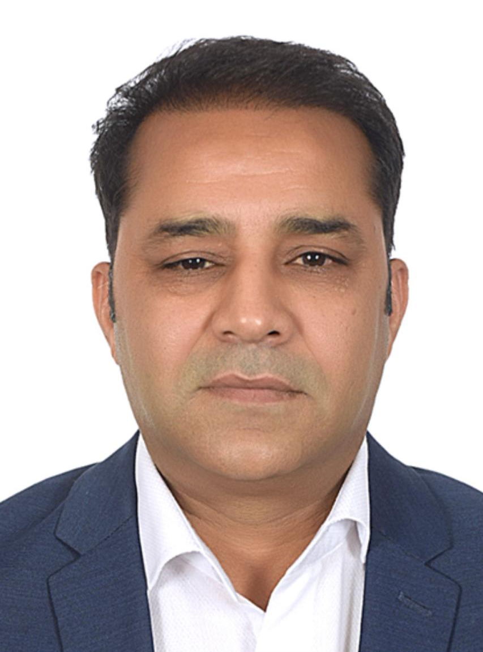
President’s Message
“Voices on Every Wall.”
Sindh Outdoor Advertisers Association (SOAA)
Outdoor isn’t just advertising — it’s storytelling on the streets.
At SOAA, we see billboards as more than space. We see potential. Our skyline is our canvas, and our mission is to make sure that every square foot of it speaks with clarity, creativity, and purpose.
As President of the Sindh Outdoor Advertisers Association, I’m proud to lead a community of innovators, strategists, and visionaries who understand the power of public space. Together, we’re reimagining what outdoor media can be — smarter, cleaner, more responsible, and deeply connected to the pulse of the city.
We stand at the intersection of business and art, policy and progress. From traditional hoardings to digital takeovers, from wall murals to street-level activations — SOAA is shaping how messages meet people in motion.
Thank you for being part of this journey. The streets are alive, and the future is wide open.
Stay bold,
Aamir Siddiqui President
Sindh Outdoor Advertisers Association (SOAA)

Slide 3
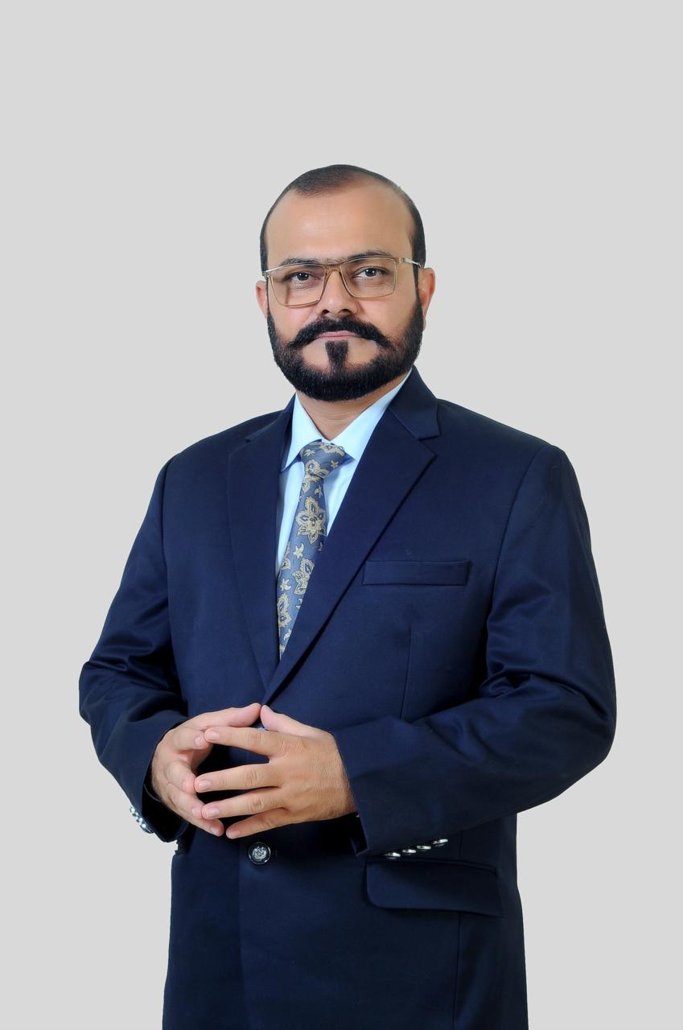
Chairman Message
After serving this industry for 30 years, I’ve witnessed it rise to success and collapse to rock bottom — not once but multiple times. Poor law and order, broken payment cycles, and mismanagement have pushed many hardworking advertisers to the edge. My vision for these two years is clear: to restore financial stability, secure smoother payment flows, and protect the working rights of every advertiser.
At the same time, we will work to rebuild client trust by creating a more organized, professional, and reliable outdoor advertising ecosystem — where brands feel confident investing and campaigns deliver results without disruption.
“A strong industry is built on fairness — when the advertiser works freely, the client invests confidently, and together, we build sustainable success.”
This is our time to fix the foundation and take this industry forward — stronger, cleaner, and more unified than ever before.

Slide 4
Vision:
To elevate Sindh’s OOH Advertising landscape and unlock the industry’s full potential through innovative, more engaging & aesthetically enriched environments.
Mission:
To unite media owners, advertisers and government, fostering a collaboration future-ready OOH ecosystem; based on technology driven & data-based innovations.

Slide 5
About Us

Slide 6
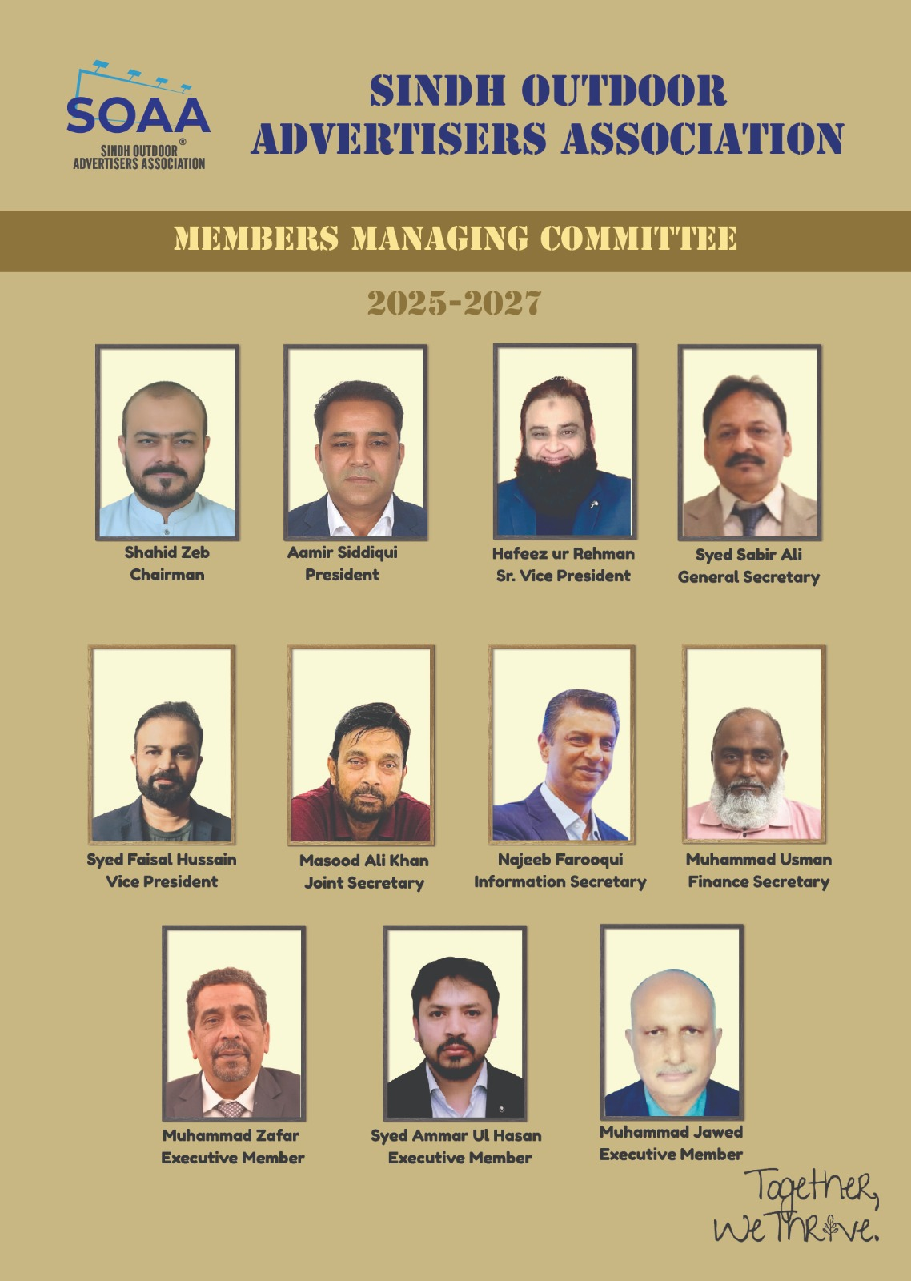
Leadership
Shahid Zaib – Chairman
Description about self
Aamir Siddique – President
Description about self
Hafeez ur Rehman – Sr. V. President
Description about self
Syed Faisal Hussain – V. President
Mr. Syed Faisal Hussain is a senior industry leader and entrepreneur with over two decades of proven excellence in the Out-of-Home (OOH) advertising sector. He entered the industry in 2001 through Vision Publicity, where he rapidly distinguished himself through operational strength, executional precision, and a deep understanding of media infrastructure.
Syed Sabir Ali – General Secretary
Description about self
Masood Ali Khan – Joint Secretary
Description about self
Najeeb Farooqi – Information Secretary
Description about self
Muhammad Usman – Finance Secretary
Have a marketing experience of more than three decades. In the initial face of my career, I was part of the marketing team at American Express Bank for 8 years where I launched and managed the Dollar Card program. From 2000 onwards, I was part of the MCB Bank marketing team where I worked a solid 18 years. I was responsible for the Nationwide Branch Branding, Giveaways, Newspaper ads, TVCs, Radio and OOH along with Payments, Procurement and Annual Budget Designing. I was also a member of the team that launched MCB Visa Credit Card back in 2006. From 2016 onwards, I am part of the OOH industry under the company name "Graphics Edge". In the core of this journey, I have worked with multiple brands from various sectors like Food, FMCG, Textile, Furniture and Construction sector.

Slide 7
Leadership
Syed Ammar ul Hasan Naqvi – Executive Member
"A highly motivated and results-oriented marketing professional with 20 years of experience in Sales & Marketing and campaign management. Proven ability to develop and implement successful marketing strategies, resulting in increased brand awareness and revenue growth.
Muhammad Zaffar – Executive Member
Description about self
Muhammad Javaid – Executive Member
Description about self

Slide 8
Committees
Sabir Ali:
Chairman – Co-Ordination Committee – I
Syed Faisal Hussain:
Chairman – Co-Ordination Committee – II
Purpose: The Co-ordination Committee – I is responsible for facilitating effective communication, collaboration, and alignment among various departments, units, or stakeholder groups within the trade union. Its role is to ensure that activities and initiatives are coordinated efficiently to achieve the union’s strategic objectives.
Key Responsibilities:
Strategic Alignment:
Ensure that different departments or units work towards common goals and adhere to the union’s policies and strategic plans.
Facilitate the implementation of union policies across various functions.
Communication and Information Sharing:
Promote open and effective communication channels among members, departments, and leadership.
Disseminate relevant information, updates, and decisions to all stakeholders in a timely manner.
Planning and Coordination of Activities:
Organize and oversee joint activities, meetings, and initiatives to ensure coherence and synergy.
Coordinate schedules, resources, and responsibilities for union programs and campaigns.
Problem Solving and Conflict Resolution:
Act as a mediator to resolve inter-departmental or stakeholder conflicts.
Address issues that may hinder the smooth functioning of union activities.
Monitoring and Evaluation:
Track the progress of coordinated activities and initiatives.
Provide feedback and recommendations for improvement to union leadership.
Policy Implementation Support:
Assist in the dissemination and enforcement of union policies and decisions across different units.
Reporting:
Prepare reports on coordination activities, challenges, and outcomes for review by senior management or the executive committee.

Slide 9
Committees
Hafeez Ur Rehman:
Chairman – Arbitration Committee
Purpose: The Arbitration Committee is responsible for resolving disputes and grievances between members, and the union through fair and impartial arbitration processes. Its goal is to ensure that conflicts are settled in accordance with union policies, legal standards, and industry practices, thereby maintaining harmony and protecting members' rights.
Key Responsibilities:
Dispute Resolution:
Hear and evaluate disputes, grievances, and claims brought forward by members or employers.
Conduct hearings impartially, ensuring all parties have the opportunity to present their case.
Investigation and Evidence Gathering:
Review relevant documents, evidence, and testimonies related to disputes.
Gather additional information as needed to make informed decisions.
Decision-Making:
Analyze facts and apply applicable laws, policies, and collective agreements to reach fair resolutions.
Issue written arbitration decisions or awards that are clear, justified, and enforceable.
Mediation and Negotiation:
Facilitate negotiations between parties to reach mutually acceptable solutions when appropriate.
Promote amicable resolutions to minimize escalation of conflicts.
Policy Compliance:
Ensure all arbitration proceedings adhere to union policies, legal requirements, and ethical standards.
Maintain confidentiality of all proceedings and documentation.
Record Keeping and Reporting:
Maintain accurate records of hearings, decisions, and outcomes.
Prepare reports on arbitration activities for union leadership and relevant stakeholders.
Training and Development:
Participate in ongoing training to stay updated on arbitration laws, procedures, and best practices.
Provide guidance and support to other union representatives involved in dispute resolution.

Slide 10
Committees
Najeeb Farooqi:
Chairman – Business Development Committee
Purpose: The Business Development Committee dedicated to client (or member) engagement is responsible for fostering strong relationships with clients, identifying opportunities to enhance services, and supporting the growth and sustainability of the trade union through strategic outreach and partnership development.
Client Relationship Management:
Build and maintain positive relationships with existing clients/members to ensure satisfaction and loyalty.
Act as a primary point of contact for client inquiries, feedback, and support needs.
Membership Growth and Retention:
Develop strategies to attract new clients/members and retain current ones.
Identify and address members’ needs to improve engagement and perceived value.
Market and Client Needs Analysis:
Conduct research to understand client requirements, industry trends, and the competitive landscape.
Use insights to tailor services and develop new initiatives that meet client expectations.
Promotion of Services and Benefits:
Promote the union’s services, programs, and benefits to existing and potential clients/members.
Organize outreach activities, seminars, and informational sessions to increase awareness.
Partnership and Collaboration Development:
Establish strategic partnerships with organizations, industry stakeholders, and service providers that benefit clients/members.
Explore opportunities for joint initiatives or programs that add value.
Feedback and Continuous Improvement:
Gather feedback from clients/members to improve services and address concerns promptly.
Implement improvements based on feedback to enhance client satisfaction.
Monitoring and Reporting:
Track client engagement metrics, satisfaction levels, and growth indicators.
Prepare reports for leadership on client-related activities, opportunities, and challenges.

Slide 11
Committees
Syed Ammar ul Hasan Naqvi:
Chairman – IT & Social Media Committee
Purpose: The IT & Social Media Committee is responsible for overseeing the trade association’s digital presence, including information technology infrastructure, online communication channels, and social media platforms. The committee aims to enhance member engagement, promote industry initiatives, and ensure the security and efficiency of digital operations.
Digital Strategy Development:
Develop and implement strategies to enhance the association’s online presence and digital engagement.
Identify opportunities for leveraging social media and digital tools to promote industry initiatives and member activities.
Social Media Management:
Oversee the creation, scheduling, and posting of content across social media platforms (e.g., LinkedIn, Twitter, Facebook).
Monitor social media channels for engagement, inquiries, and industry trends.
Develop campaigns to increase followers, engagement, and industry awareness.
IT Infrastructure Oversight:
Ensure the security, reliability, and efficiency of the association’s IT systems and networks.
Collaborate with IT service providers to maintain hardware, software, and cyber security measures.
Content Creation and Management:
Coordinate the development of digital content such as newsletters, blogs, videos, and webinars.
Maintain the association’s website, ensuring content is current, accurate, and accessible.
Member Engagement and Support:
Facilitate communication channels for members through digital platforms.
Provide support and training to members on digital tools and social media best practices.
Monitoring and Reporting:
Track analytics related to website traffic, social media engagement, and digital campaigns.
Prepare reports on digital activity performance and recommend improvements.
Policy and Compliance:
Ensure all digital activities comply with relevant privacy laws, data protection regulations, and industry standards.

Slide 12
Committees
Muhammad Zaffar:
Chairman – Fabrication Committee
A fabrication committee within a trade association typically has the following job responsibilities:
Developing Standards and Best Practices: Establish and promote industry standards, guidelines, and best practices related to fabrication processes to ensure quality, safety, and consistency across the industry.
Policy and Advocacy: Advocate for policies and regulations that benefit the fabrication sector, representing the interests of member organizations within the trade association.
Education and Training: Organize seminars, workshops, and training programs to enhance the skills and knowledge of industry professionals involved in fabrication activities.
Industry Collaboration: Facilitate communication and collaboration among members, manufacturers, suppliers, and other stakeholders to address common challenges and share innovations.
Research and Development: Support or initiate research projects aimed at improving fabrication techniques, materials, and technologies.
Quality Assurance: Monitor industry trends and ensure that fabrication practices adhere to established standards, promoting quality and safety.
Membership Engagement: Encourage active participation from members in committee activities and initiatives to foster a collaborative industry environment.
Reporting and Documentation: Prepare reports, publications, and updates on industry developments, standards, and committee activities for dissemination among members and stakeholders.

Slide 13
Committees
Muhammad Javaid:
Chairman – CSR Committee
Purpose: The CSR Committee is responsible for guiding and promoting the trade association’s initiatives related to corporate social responsibility. Its goal is to foster sustainable practices, community engagement, and ethical standards among member organizations, thereby enhancing the industry’s positive impact on society and the environment.
Key Responsibilities:
Develop CSR Strategies:
Formulate and recommend CSR policies and initiatives aligned with industry values and community needs.
Identify key areas such as environmental sustainability, social welfare, education, and community development.
Promote Member Engagement:
Encourage member organizations to adopt and implement CSR practices.
Facilitate knowledge sharing, best practices, and success stories among members.
Program Planning and Implementation:
Design and oversee CSR projects, campaigns, and partnerships with NGOs, government agencies, and community groups.
Monitor the progress and impact of CSR initiatives.
Awareness and Education:
Organize workshops, seminars, and awareness campaigns to promote CSR principles within the industry.
Provide resources and guidance to members on integrating CSR into their business operations.
Monitoring and Reporting:
Track the outcomes and social/environmental impact of CSR activities.
Prepare reports and communicate results to stakeholders, including members, industry partners, and the public.
Compliance and Ethical Standards:
Ensure CSR activities adhere to legal requirements, ethical standards, and best practices.
Promote transparency and accountability in all CSR endeavors.

Slide 14
1. Create Account:
SOAA Member will create his account and use the member portal.
2. Become a member:
New Member fill the form online, after submitting the form Managing Body will approved the same.
3. Member Benefit:
Industry Representation and Advocacy:
Gain a collective voice to advocate for favorable policies, regulations, and industry standards.
Influence legislative and regulatory decisions affecting the OOH media sector.
Networking Opportunities:
Connect with industry peers, advertisers, agencies, and other stakeholders through events, seminars, and forums.
Build strategic partnerships and collaborations to expand business opportunities.
Knowledge Sharing and Best Practices:
Access industry reports, research, and market insights to stay informed about trends and innovations.
Participate in workshops and training sessions to enhance operational efficiency and technological adoption.
Business Development and Lead Generation:
Benefit from the association’s promotional activities, directories, and industry events to attract new clients and advertisers.
Increase visibility among potential partners and customers.
Access to Industry Resources:
Utilize resources such as legal guidance, standardization documents, and technical support.
Stay updated on compliance requirements and industry regulations.
Brand Credibility and Industry Recognition:
Enhance reputation by being associated with a reputable trade body.
Participate in awards, recognition programs, and industry rankings to showcase achievements.
Collaborative Marketing and Campaigns:
Engage in joint marketing initiatives, campaigns, and industry promotions organized by the association.
Leverage collective branding to increase market presence.
Cost Savings and Support Services:
Access discounted rates for events, training, and industry services.
Receive support in dispute resolution, legal matters, and industry challenges.

Slide 15
1. Advertiser Benefit:
Any company that is involved in the design, planning, or media buying of OOH – including advertisers, ad agencies, and media buying services – can take advantage of comprehensive service and support, including:
Marketing Research
OOH Studies – the most extensive OOH research library available on the value of OOH and how it amplifies other media investments. ROI research shows how OOH competes with TV, and outperforms radio, print, and digital display, and significantly boosts the ROI of search. Nielsen’s online activation survey reveals OOH drives online activity much more efficiently than any other offline media channel and banner ads
Demographic Reports – insights into customized geographies (Karachi Metropolitan, Sindh Urban & Rural Areas) and key demographics such as age, gender, race/ethnicity, education, marital status, population density, and much more.
National Conference + Expo – this major annual industry event delivers the latest insights on the exciting evolution and potential of OOH media in the digital age. Loaded with thought-provoking speakers and programs, the conference also offers endless networking opportunities with key industry decision makers.
OOH Education – this downloadable OOH capabilities presentation is designed for ad agencies but can easily be customized for direct client usage. It covers the state of the industry, the latest consumer research, reviews outstanding creative examples and highlights time-saving tools like the OOH media locator, SQAD for OOH, the Planning for OOH Media Guide, and much more. We even offer in-person OOH education directly to your team.

